Slide 1

Deep Learning Multi-Class Classification Using Keras
This presentation explores the process of building and evaluating a multi-class classification model using Keras, a popular deep learning library. We will compare the performance of a best practices model with a model designed using Keras Tuner.
Krishna Khandelwal
S1364040

Slide 2
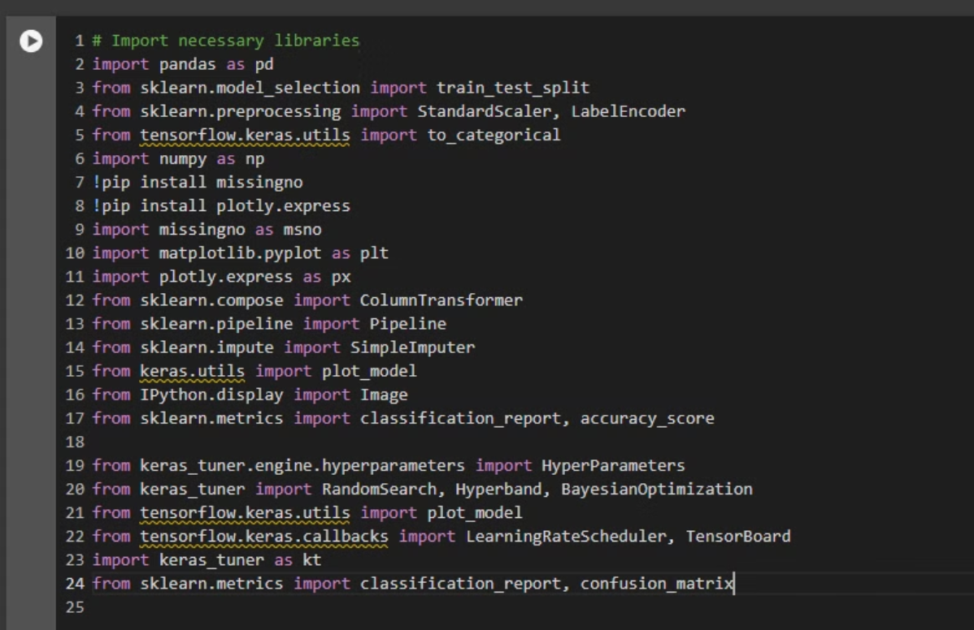
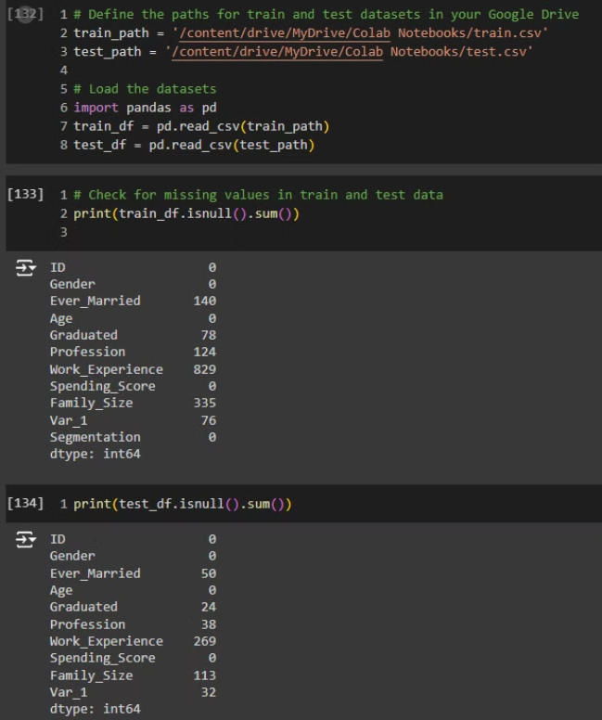
Importing Key Libraries: You imported essential libraries for data manipulation (pandas, numpy), machine learning (scikit-learn for model selection, preprocessing, etc.), and deep learning (tensorflow and keras for neural network modeling).
Data Preprocessing: You brought in tools like train_test_split (to split data into training and test sets), StandardScaler (for feature scaling), and SimpleImputer (for handling missing values).
Visualization: You installed and imported missingno and plotly.express to visualize missing data and generate plots. You also used matplotlib for additional plotting.
Modeling and Tuning: You imported Keras libraries for building and visualizing models (plot_model), and tools like keras_tuner for hyperparameter tuning, allowing you to optimize the model with techniques such as RandomSearch and BayesianOptimization.
Performance Evaluation: You included metrics such as classification_report and confusion_matrix from sklearn to evaluate model accuracy and classification performance.

Slide 3
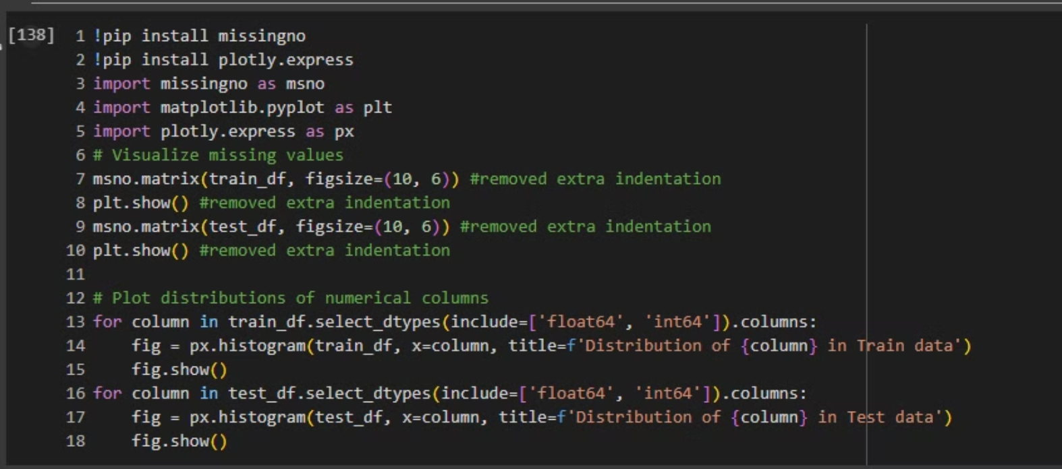
Visualizing Missing Values:Using the missingno.matrix() function, you're visualizing missing data in both the training (train_df) and test datasets (test_df). The msno.matrix() function gives a matrix plot showing the presence or absence of data for each column. You called plt.show() to display the plot for both datasets.
Plotting Data Distributions: I looped through all the numerical columns (of types float64 and int64) in both the train_df and test_df datasets. For each column, you created a histogram using plotly.express (px.histogram) to visualize the distribution of each feature in both datasets. Each histogram is dynamically generated with a title to indicate which column's distribution is being shown, and fig.show() renders the plot.

Slide 4
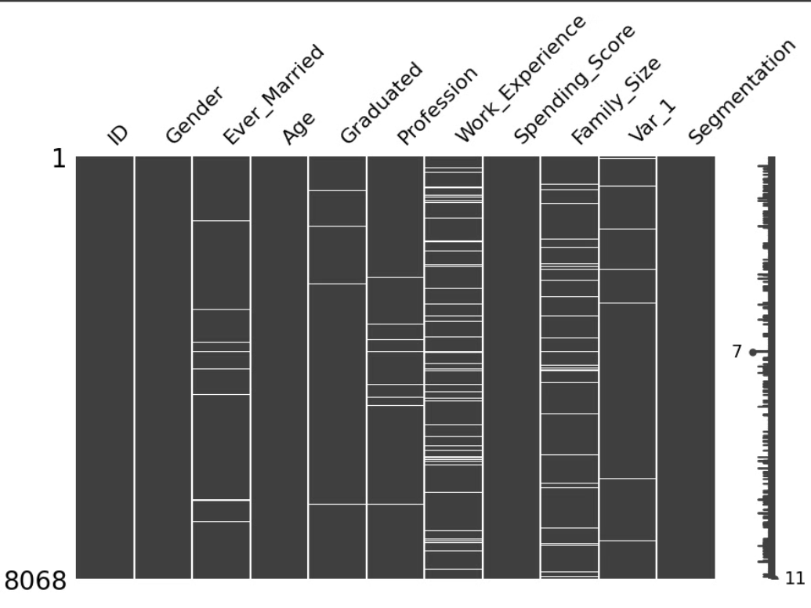
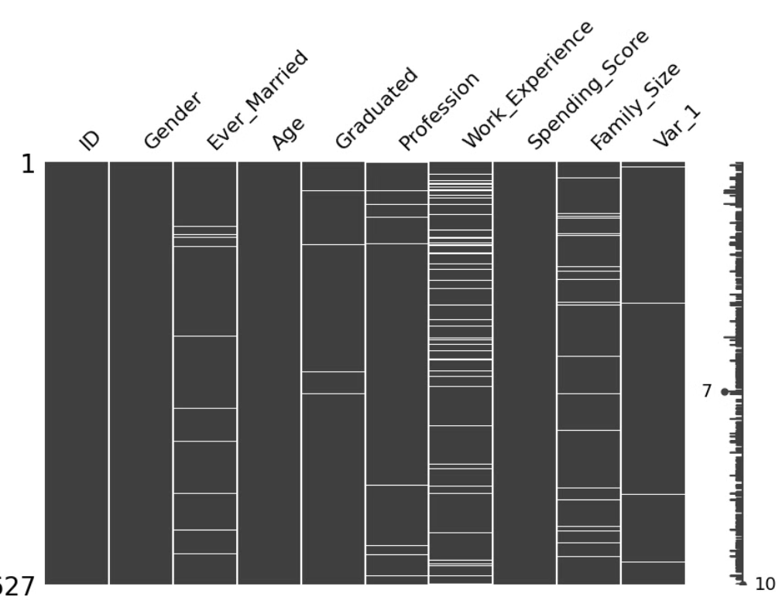

Slide 5
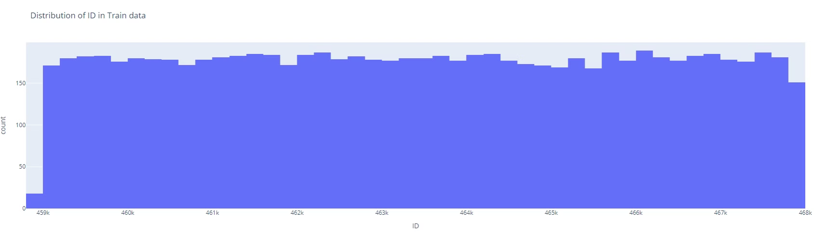
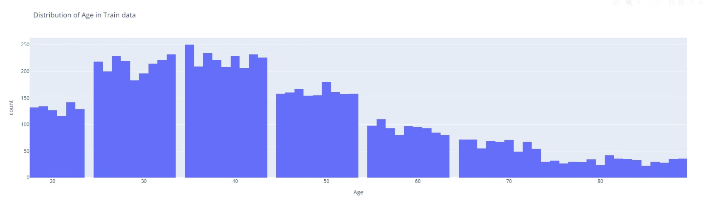
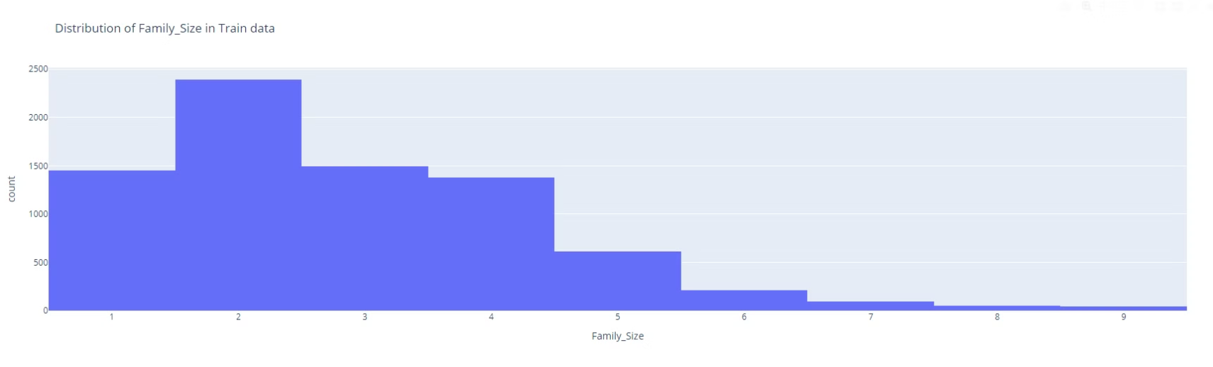
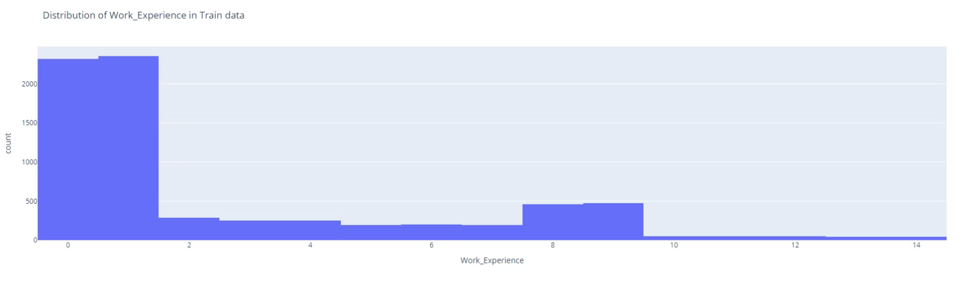

Slide 6
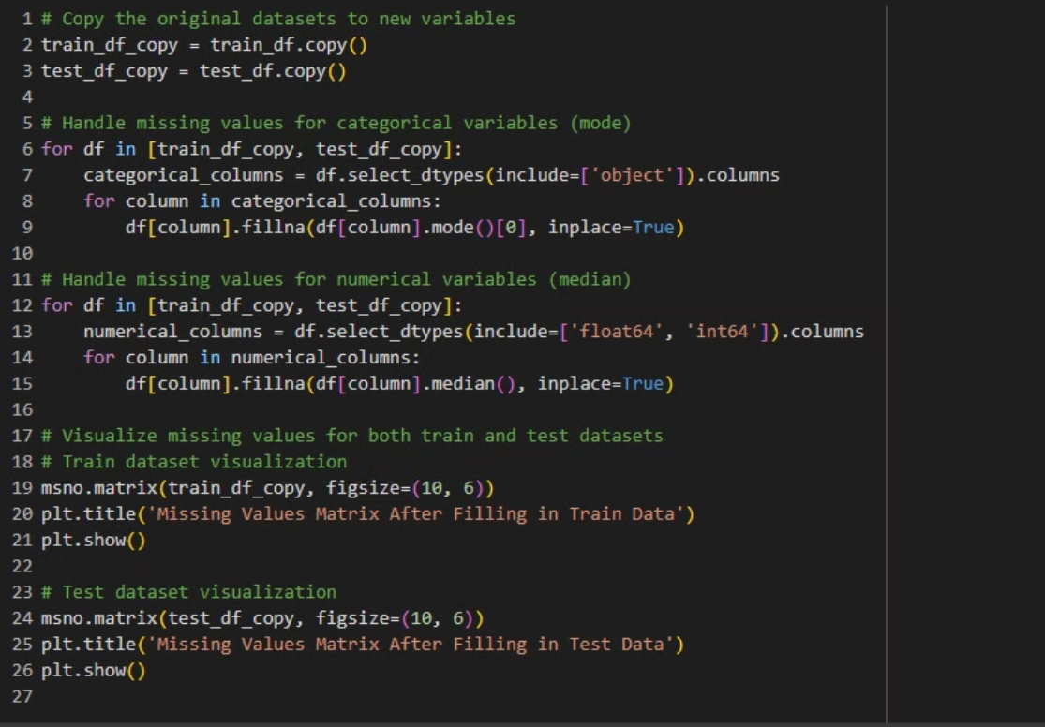
Copied the original datasets into new variables train_df_copy and test_df_copy to preserve the originals.
Filled missing values for categorical variables in both datasets using the mode of each column.
Handled missing values for numerical variables by filling them with the median of each respective column.
Visualized missing data post-imputation using missingno.matrix() for both the modified train and test datasets, ensuring missing data was addressed.
Displayed missing values matrix with a clear title for both datasets after filling, confirming the changes visually.

Slide 7
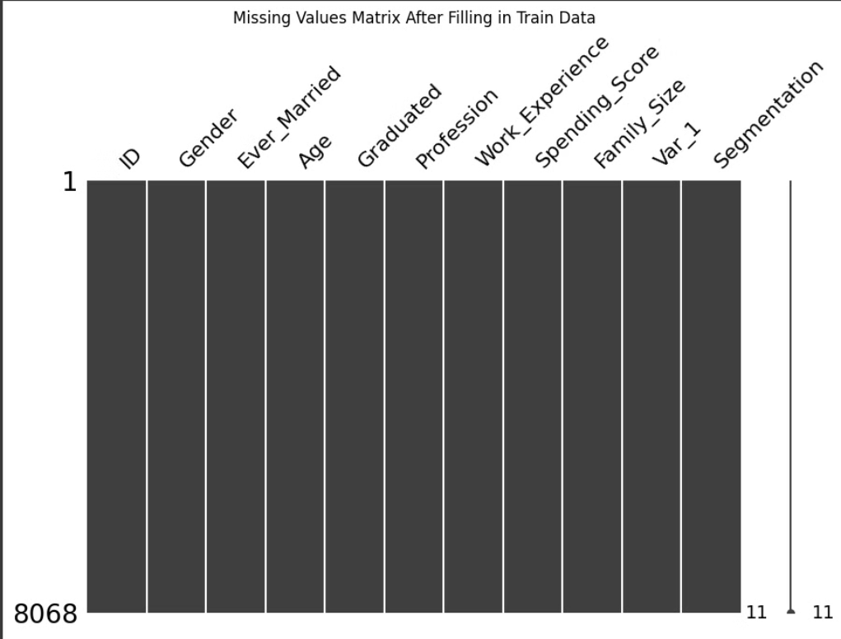
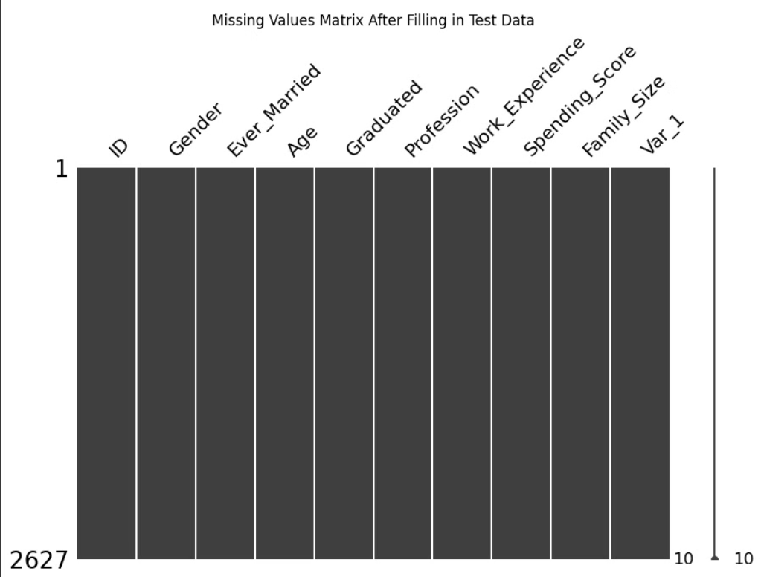

Slide 8
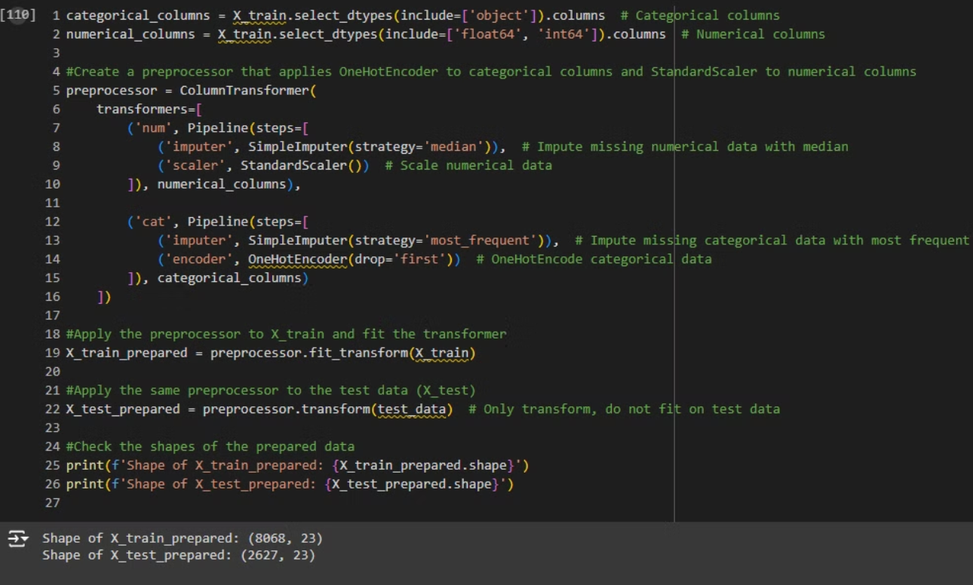
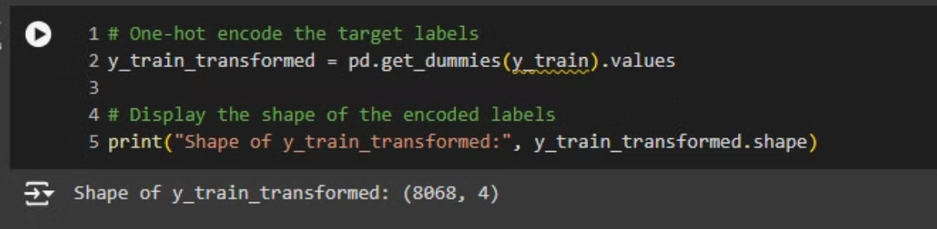

Slide 9
Identified categorical and numerical columns in X_train using select_dtypes(), storing them in categorical_columns and numerical_columns respectively.
Created a preprocessor using ColumnTransformer to handle both categorical and numerical columns:
Numerical columns are imputed using the median and scaled with StandardScaler.
Categorical columns are imputed using the most frequent value and one-hot encoded using OneHotEncoder.
Applied the preprocessor to X_train by fitting and transforming the data and then transformed X_test using the same preprocessor (without fitting on the test data).
Checked the shape of the transformed data for both X_train and X_test to confirm that preprocessing was applied correctly.
One-hot encoded the target labels (y_train) using pd.get_dummies() and printed the shape of the transformed labels to verify the encoding.

Slide 10
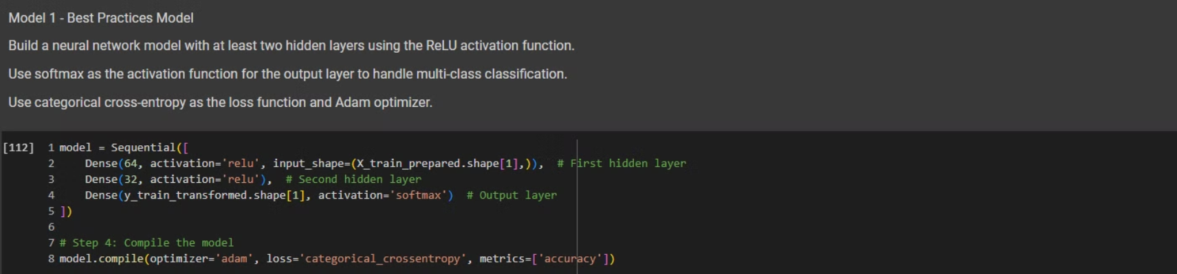
Defined a Sequential neural network model:
First hidden layer: A Dense layer with 64 units, ReLU activation, and input shape based on the number of features in X_train_prepared.
Second hidden layer: A Dense layer with 32 units and ReLU activation.
Output layer: A Dense layer with units equal to the number of classes in y_train_transformed, using softmax activation for multiclass classification.
Compiled the model using the Adam optimizer and categorical crossentropy loss (appropriate for multiclass classification). The model's performance will be evaluated using accuracy as a metric.

Slide 11
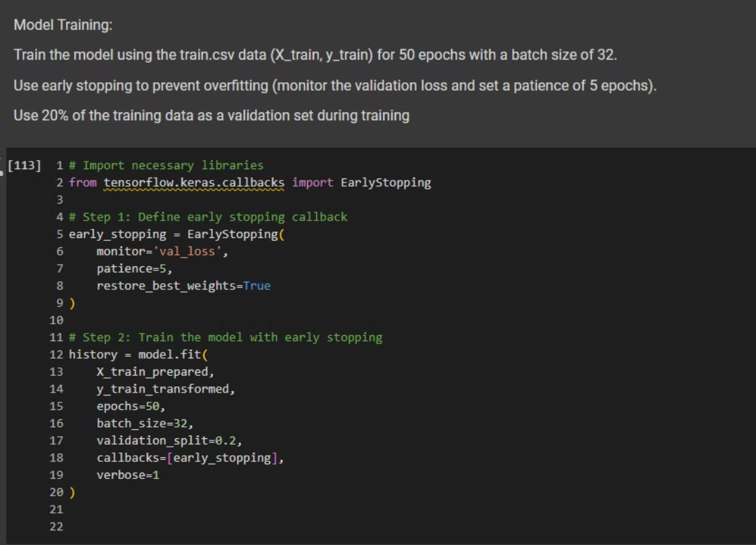
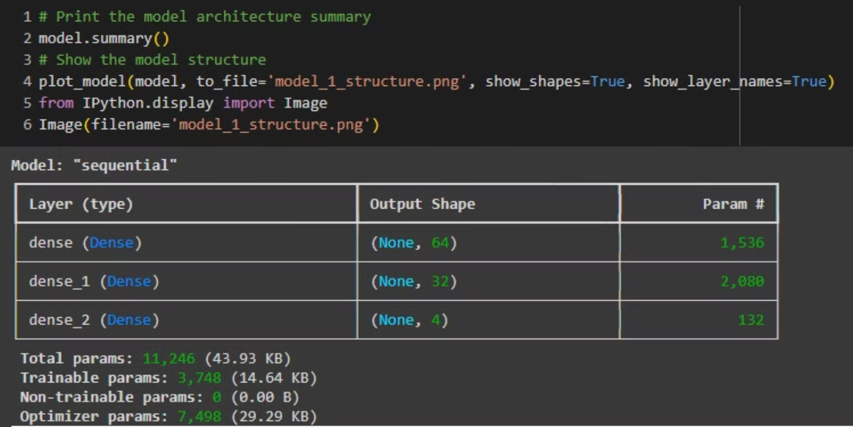

Slide 12
Imported the EarlyStopping callback from tensorflow.keras.callbacks to monitor validation loss and stop training if it doesn’t improve for 5 epochs (patience of 5), while restoring the best weights.
Defined the early stopping callback by setting it to monitor the val_loss and restoring the best weights when training stops.
Trained the model on the training data (X_train_prepared, y_train_transformed) for up to 50 epochs, using a batch size of 32.
The training data as a validation set (validation_split=0.2).
Early stopping was used to avoid overfitting by stopping the training when validation loss stops improving.
Printed the model summary to review the architecture and layers of the model, confirming the structure before training.
This approach ensures efficient training while minimizing overfitting.

Slide 13
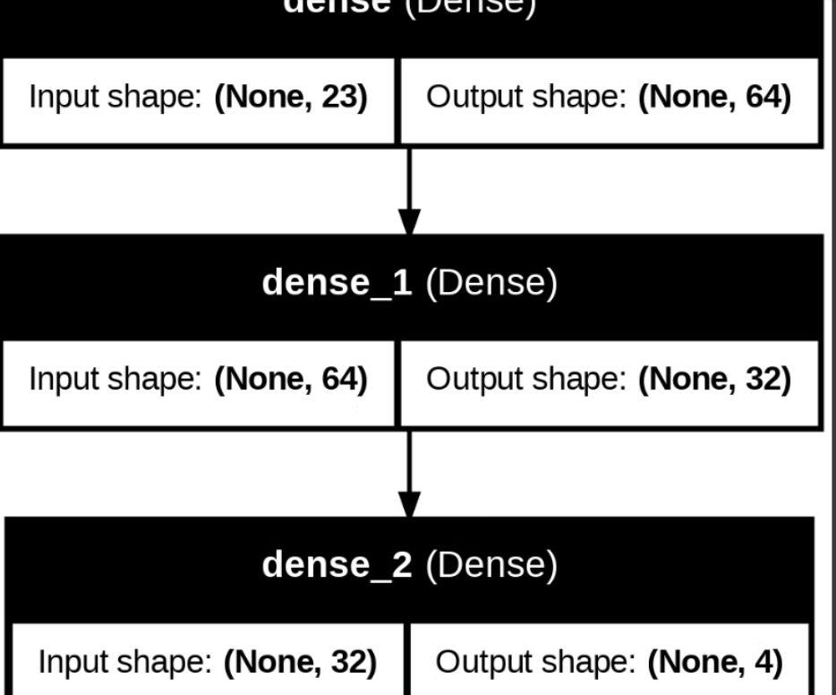

Slide 14
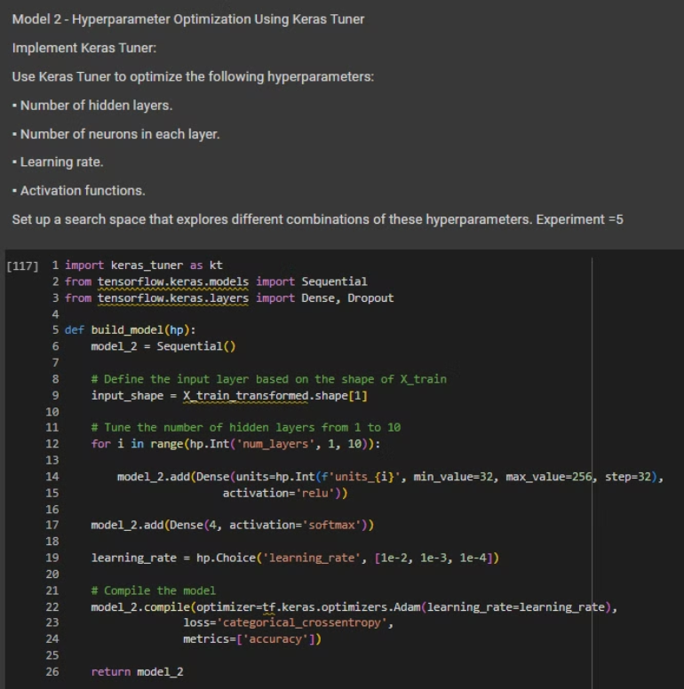
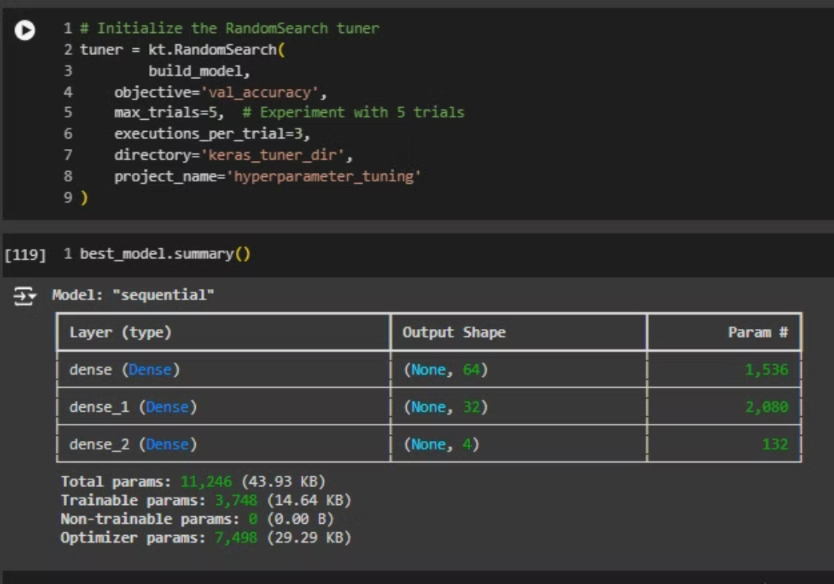
Model 2 - Hyperparameter Optimization using Keras Tuner:

Slide 15
Defined a function (build_model) for Keras Tuner to explore the search space:
You defined a sequential model.
Tuned the number of hidden layers (from 1 to 10).
Tuned the number of neurons in each hidden layer (from 32 to 256 with a step of 32).
Added the output layer with softmax activation for multiclass classification.
Tuned the learning rate with options [1e-2, 1e-3, 1e-4].
Set up the Keras Tuner search:
You used tuner.search() to explore different combinations of hyperparameters by training the model on the training data (X_train_transformed and y_train_encoded) for 20 epochs, with early stopping and a 20% validation split.
Retrieved the best hyperparameters:
After the search, you retrieved the best hyperparameters found by the tuner using tuner.get_best_hyperparameters().
Built and trained the best model:
You constructed the best model (best_model) using the optimal hyperparameters and trained it on the training data for 50 epochs with early stopping, using a batch size of 32 and a 20% validation split.
This approach allows you to automate the process of finding the best combination of hyperparameters and optimizes the model for better performance.

Slide 16
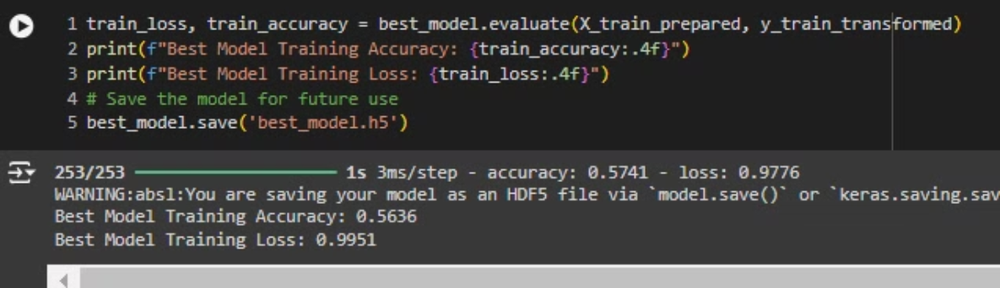
Evaluated the best model:
You evaluated the performance of the best model (found using Keras Tuner) on the training data (X_train_prepared, y_train_transformed) to obtain the training loss and accuracy.
Printed the training metrics:
The training accuracy and loss were printed with formatting to display up to four decimal places for clarity (train_accuracy:.4f, train_loss:.4f).
Saved the best model:
You saved the trained best model using the .save() method, which stores the model in an HDF5 file (best_model.h5) for future use, allowing you to reload it without retraining.
This ensures you can evaluate and preserve the model for further predictions or deployment.

Slide 17
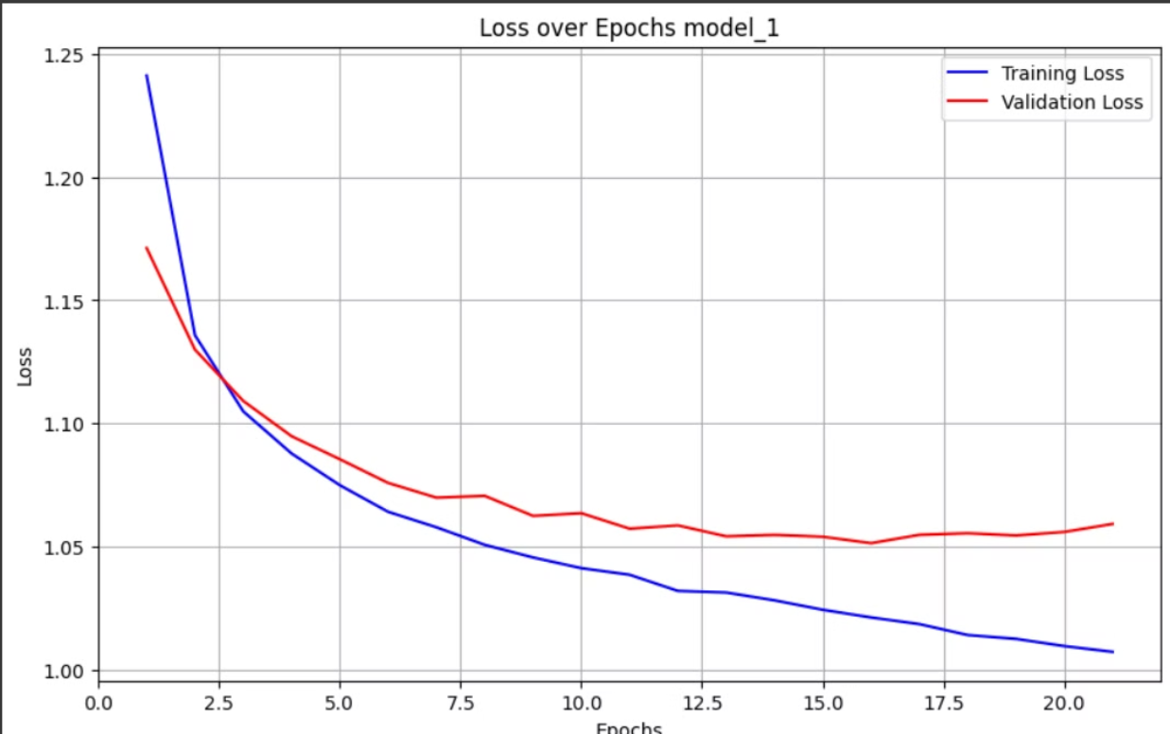
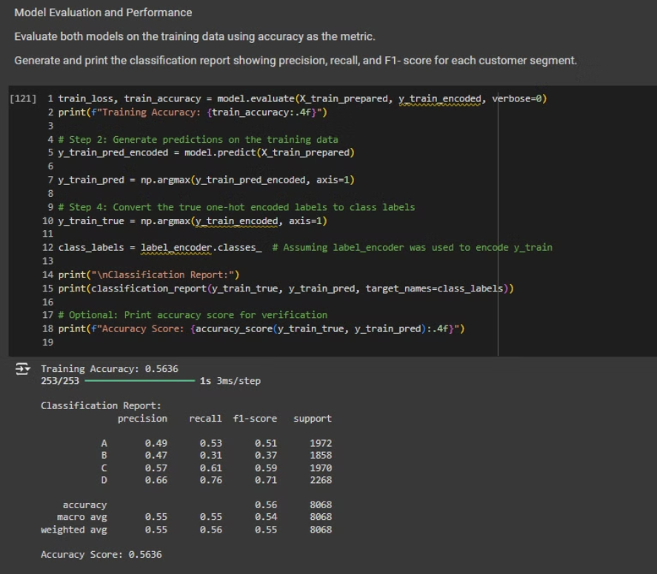
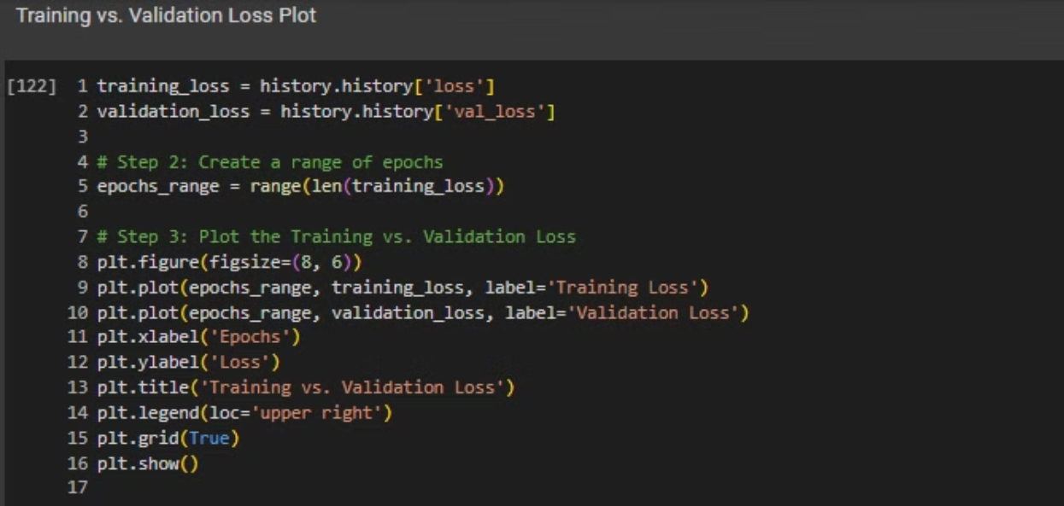

Slide 18
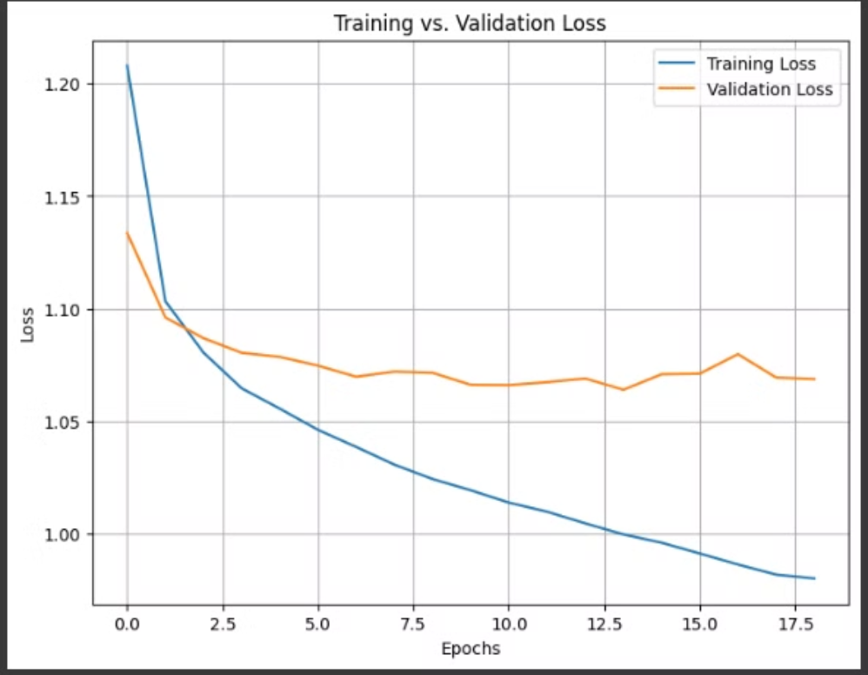
Evaluated the model on the training data:
I evaluated the trained model's performance by calculating training loss and accuracy using model.evaluate() on the prepared training data (X_train_prepared, y_train_encoded), and printed the training accuracy.
Generated predictions on the training data:
I used model.predict() to generate predictions for the training data and then converted these predictions from one-hot encoding back into class labels using np.argmax().
Converted true labels to class labels:
I converted the true labels (y_train_encoded) from one-hot encoding back into class labels using np.argmax(), ensuring consistency with the predicted labels.
Printed a classification report:
I printed the classification report (which includes precision, recall, and F1-score) using classification_report() with the true and predicted class labels, specifying target_names as the class labels (assuming label_encoder was used).
Printed the accuracy score:
I verified the classification performance by printing the accuracy score using accuracy_score() for a numerical summary of accuracy.
Visualized training vs. validation loss:
The plot was labeled appropriately to visualize how loss evolved during training, helping you identify potential overfitting or underfitting.
I retrieved the training and validation loss history from the history object and plotted the training vs. validation loss over the epochs using matplotlib.
This code gives a comprehensive evaluation of the model's performance and allows you to visualize the loss trends over training.

Slide 19
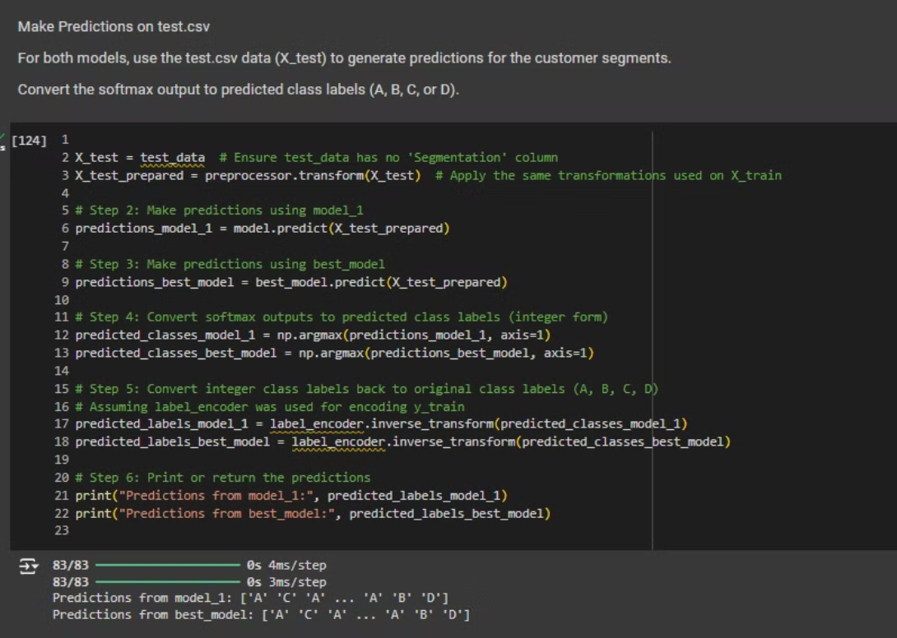
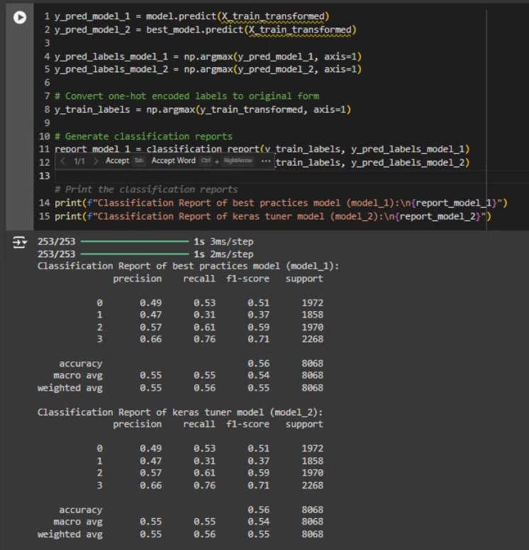

Slide 20
Preprocessed the test data:
If the test data (test_data) doesn't contain a 'Segmentation' column (i.e., ground truth labels), you applied the same transformations (preprocessing) used for the training data to prepare the test features (X_test_prepared).
Generated predictions:
You generated predictions using both model (referred to as model_1) and best_model by applying them to the preprocessed test data (X_test_prepared).
Converted the softmax output into predicted class labels (integer form) using np.argmax().
Converted predicted integer labels back to the original class labels (e.g., 'A', 'B', 'C', 'D') using label_encoder.inverse_transform() for both models (model_1 and best_model).
Handled cases with ground truth labels:
If the 'Segmentation' column is present in test_data, you:
Extracted features (X_test) and ground truth labels (y_test).
Preprocessed the test features.
Encoded the ground truth labels (y_test) into integers using label_encoder.
Computed confusion matrices:
For both model_1 and best_model, you generated confusion matrices using the ground truth (y_test_encoded) and predicted labels.
Plotted heatmaps of the confusion matrices:
For both models, you created heatmaps of the confusion matrices using seaborn.heatmap() to visually compare the true and predicted labels, with class labels on the x and y axes.
Handled cases without ground truth labels:
If the 'Segmentation' column is missing, you printed a message indicating that the confusion matrix couldn't be generated due to the absence of ground truth labels.
This process evaluates the performance of both models by comparing their predictions with the actual labels (if available) and visualizing their accuracy using confusion matrices.

Slide 21
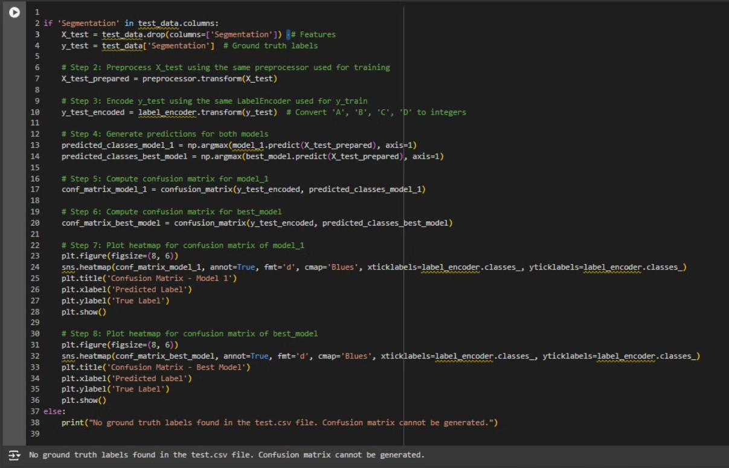

Slide 22




Confusion Matrix
The confusion matrix provides a visual representation of the model's classification performance. It shows the number of true positives, false positives, true negatives, and false negatives for each class. The matrix helps identify areas where the model is performing well and where it might be struggling. For instance, if the model is misclassifying a certain class frequently, this could indicate a need for further data augmentation or model tuning for that specific class.
True Positives
False Positives
True Negatives
False Negatives
The model correctly predicted a class label.
The model incorrectly predicted a class label. This is also known as a type I error.
The model correctly did not predict a class label.
The model incorrectly did not predict a class label. This is also known as a type II error.

Slide 23
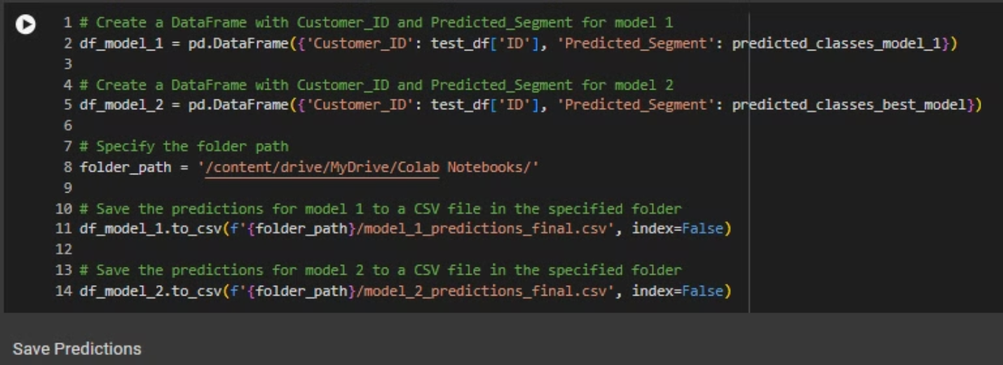
Created DataFrames with Customer_ID and predicted segments:
For both model_1 and best_model, you created two DataFrames (df_model_1 and df_model_2), each containing the Customer_ID from the test dataset (test_df['ID']) and the predicted segment labels (predicted_classes_model_1 and predicted_classes_best_model).
Specified the folder path:
You defined folder_path as the directory where the prediction files will be saved. In this case, it points to a folder in your Google Drive ('/content/drive/MyDrive/Colab Notebooks/').
Saved the predictions to CSV files:
You saved the DataFrame df_model_1 (containing predictions from model_1) to a CSV file named model_1_predictions_final.csv.
Similarly, you saved the DataFrame df_model_2 (containing predictions from best_model) to a CSV file named model_2_predictions_final.csv.
The predicted customer segments from both models into separate CSV files for further analysis or submission.

Slide 24
Recommendations for Customer Segmentation
By analyzing the customer data, the model can identify distinct groups of customers with similar characteristics and behaviors. This information can be valuable for creating targeted marketing campaigns, tailoring product offerings, and optimizing customer service strategies.
Targeted Marketing
Product Development
Customer Service
By understanding customer segments, businesses can tailor marketing messages and campaigns to appeal to specific groups, increasing the effectiveness of their marketing efforts.
Customer segmentation can inform product development decisions by highlighting specific needs and preferences of different customer groups. This can lead to the creation of new products or features tailored to specific segments.
Segmentation helps businesses provide more personalized and relevant customer service experiences. This can lead to improved customer satisfaction and loyalty.

Slide 25
COLAB LINK:https://colab.research.google.com/drive/1gKmxy4n1YStd7Ixd2uw9Z-6wfU6qhRn7?usp=sharing

Slide 26
THANK YOU

